Slide 1
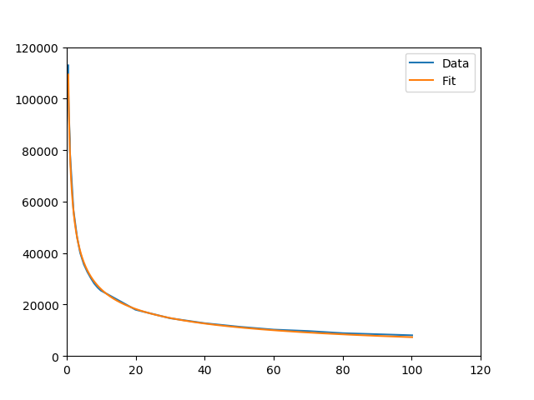
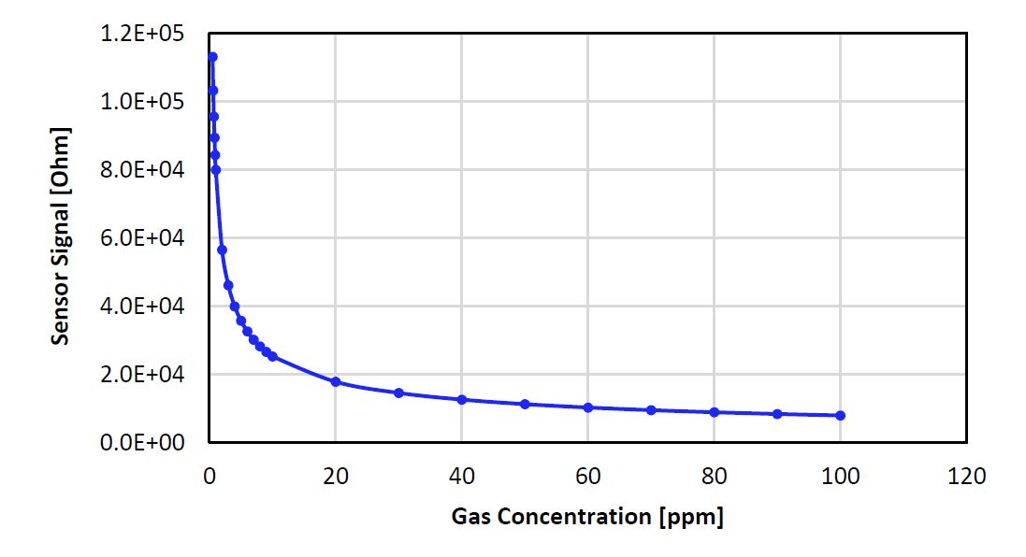
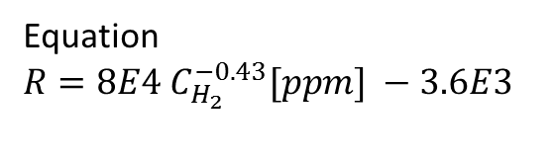
2nd – response curve
$R\left(C_{H2}\right)$
Overlay of given response curve and sampled + fitted curves
Equation
$R=8E4 C_{H_{2}}^{−0.43}[ppm] −3.6E3$

Slide 2
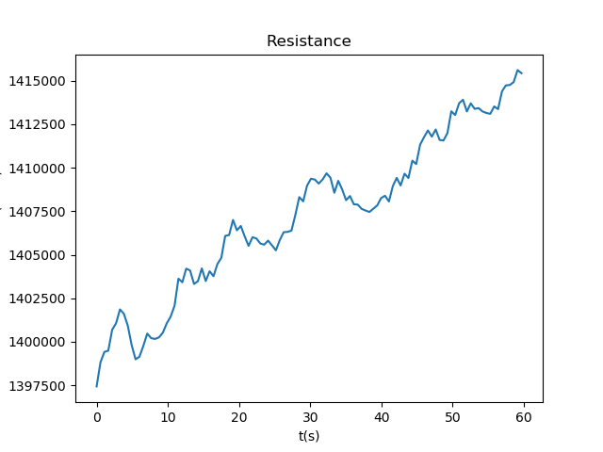
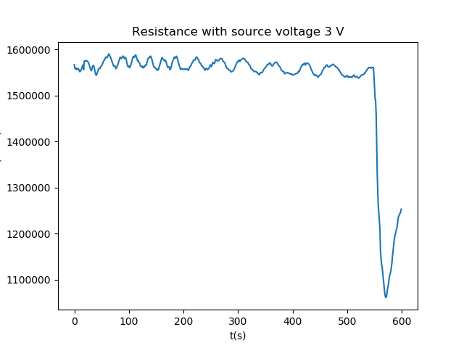
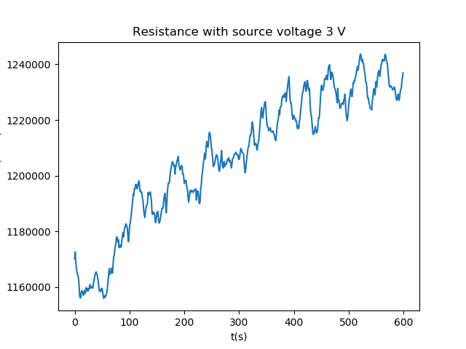
2nd sensor – sensor calibration with full H2
Tested with both the SM and the Keithley 2110 DMM
General trend in data: resistance increases slowly during some measurements, with both the DMM and the SM But with the SM it seemed to stabilise during some measurements, although some weird drop appear there
SM measured using voltage sourcing of 3V
DMM
SM
SM

Slide 3
2nd sensor – sensor calibration with full H2
Continued measuring with the sourcemeter while varying the source voltage to see if a certain voltage led to more accurate results

